Slide 1
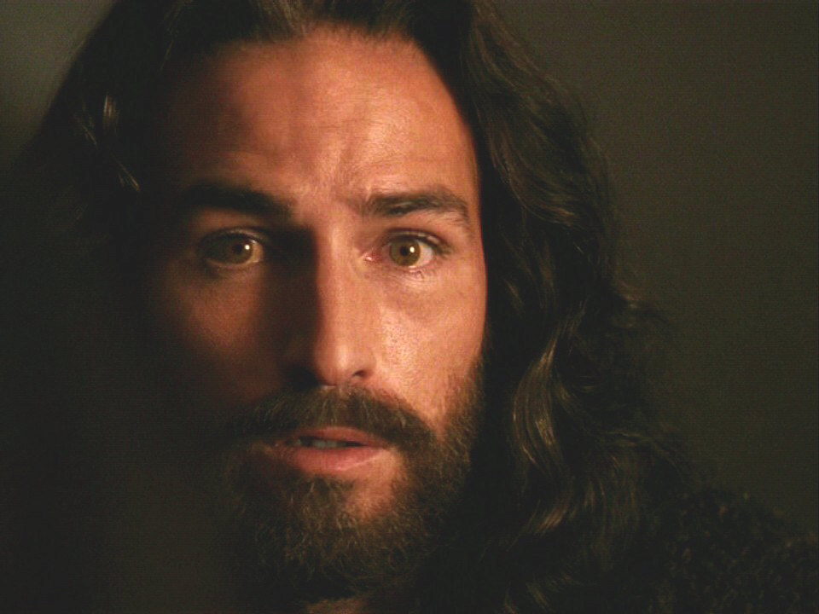
The Resurrection of Jesus Christ
John 20
Christology: The Person & Work of Jesus
Dr. Rick Griffith • Jordan Evangelical Theological Seminary • BibleStudyDownloads.org

Slide 2
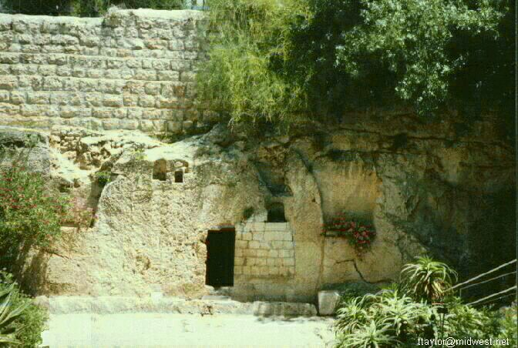
Why is it important for Jesus to be alive?
Notes:
2

Slide 3
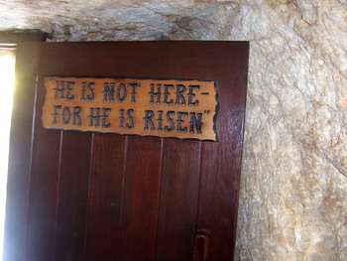
We live because He lives!

Slide 4
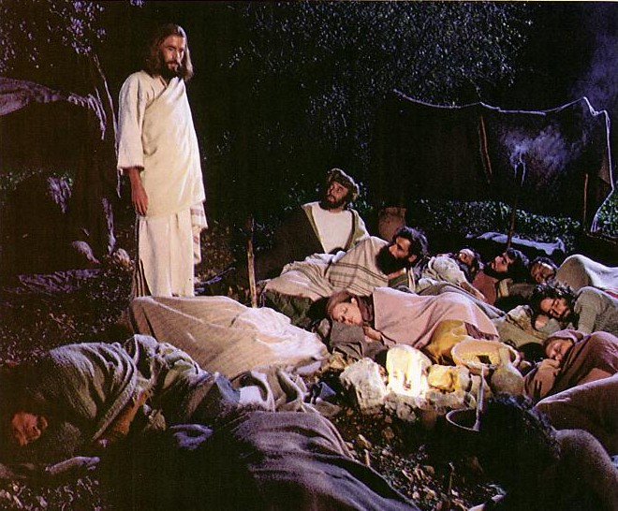
Jesus controlled His own arrest (John 18:1-11).

Slide 5
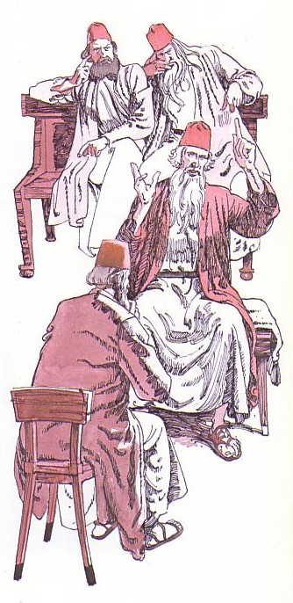
Jesus' illegal trials proved Him innocent (18:12-19:16a).

Slide 6
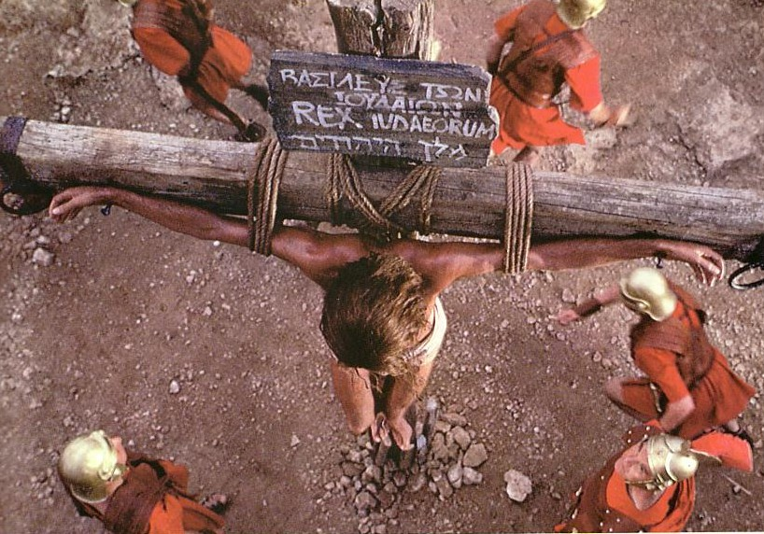
Jesus' death paid for our sin (19:16b-42)

Slide 7
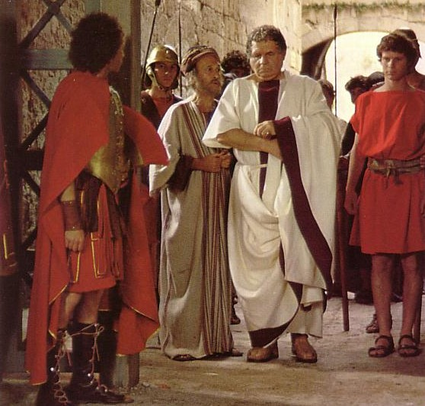
“Make the tomb secure!”

Slide 8
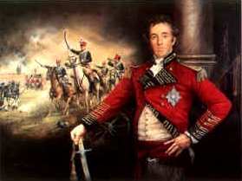
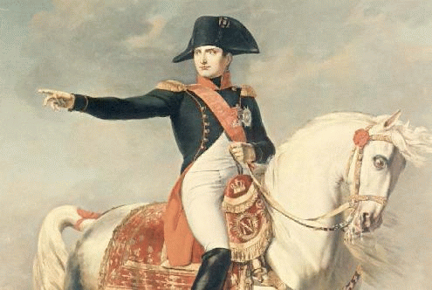
Battle News
Wellington defeated
Napoleon at Waterloo
Jesus defeated
Satan at Calvary
Notes:
8
8

Slide 9
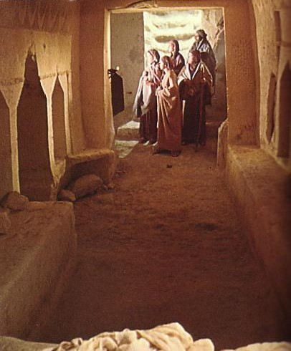
John's Key Idea:
Jesus' resurrection meets each of us at our point of need (John 20).

Slide 10
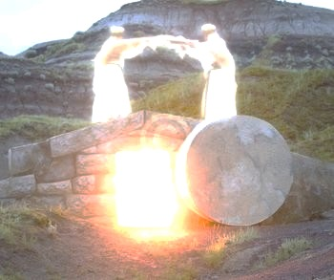
I. The empty tomb shows us that Christ is alive today (20:1-9).

Slide 11
“The Gospel of John” ® Movie
John 20:1-9
Notes:
11

Slide 12
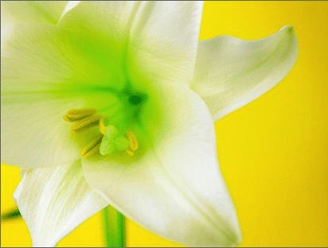
Three Initial Witnesses
Mary (1-2)
John (3-5)
Peter (6-9)

Slide 13
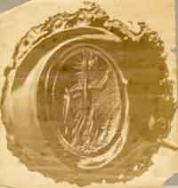
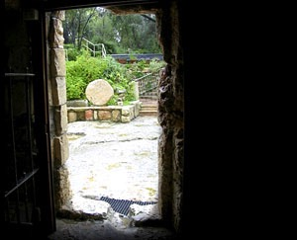
From Inside the Tomb Looking Out
The Roman seal prevented tampering
Notes:
13
13

Slide 14
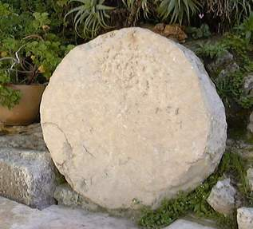
The stone was rolled away…
Notes:
14
14

Slide 15
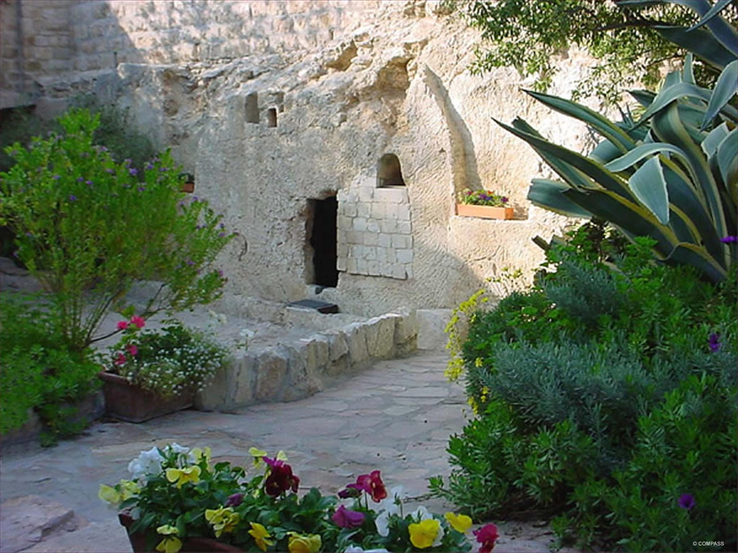
The Garden Tomb
Notes:
15
15

Slide 16
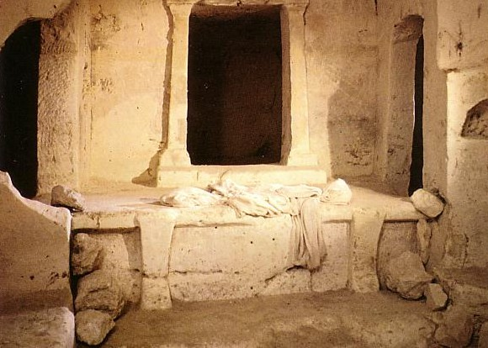
Empty linens

Slide 17
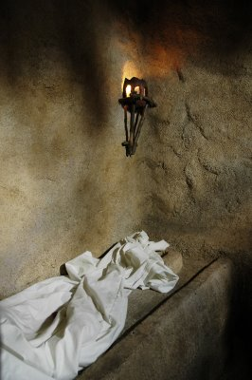
“Seeing” in 20:5-8
John “looked” v. 5
John “saw” v. 8
“peeped”
“perceived”
Peter “saw” v. 6
“beheld attentively”
Notes:
17
17

Slide 18
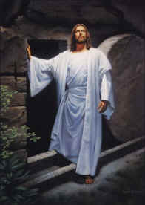
II. Christ's resurrection meets you at your need (20:10-29)
Comforts the despairing Mary (10-18)
Notes:
18
18

Slide 19
“The Gospel of John” ® Movie
John 20:10-18
Notes:
19

Slide 20
II. Christ's resurrection meets you at your need (20:10-29)
Comforts the despairing Mary (10-18)
Encourages the discouraged disciples (19-23)
Notes:
20
20

Slide 21
“The Gospel of John” ® Movie
John 20:19-23
Notes:
21

Slide 22
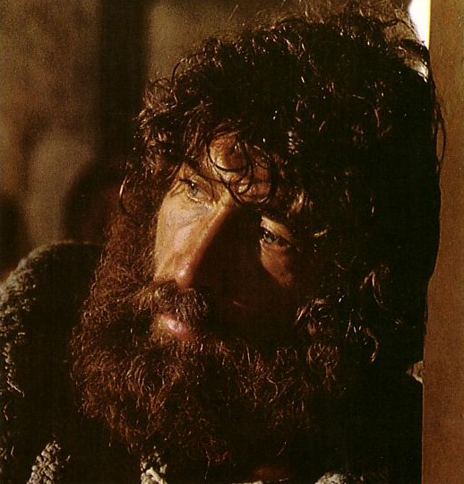
What would it take to turn the despondent Peter around?

Slide 23
II. Christ's resurrection meets you at your need (20:10-29)
Comforts the despairing Mary (10-18)
Encourages the discouraged disciples (19-23)
Gives proof to the doubting Thomas (24-29)
Notes:
23
23

Slide 24
“The Gospel of John” ® Movie
John 20:24-29
Notes:
24

Slide 25
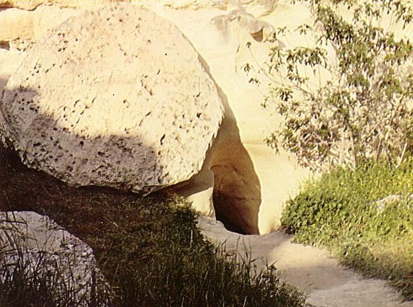
Who moved the stone?
He never died?
Jesus' strength?
Romans?
Jewish Leaders?
Disciples?

Slide 26
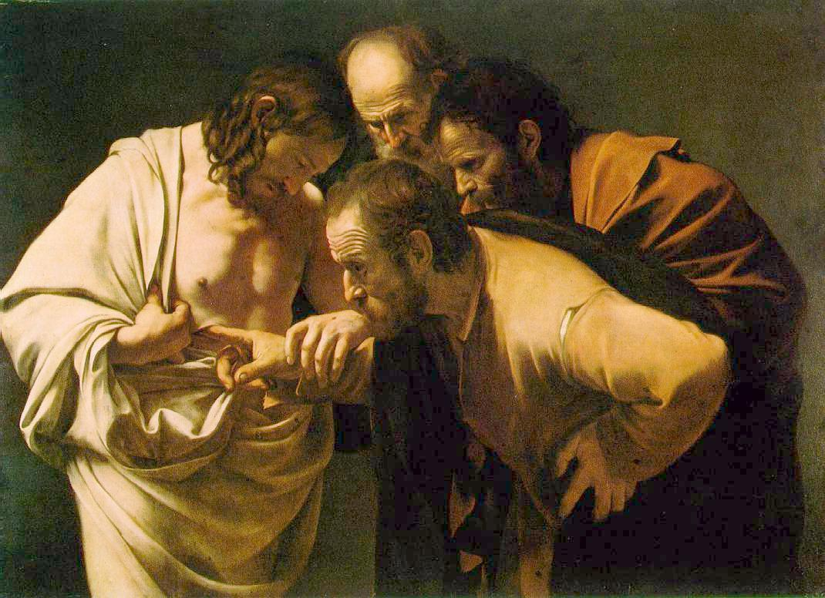
Why did John write about Jesus' miracles?
III. All of Christ's miracles are to bring us to faith in Him (20:30-31)
These [signs] are written so that you may believe that Jesus is the Christ, the Son of God, and that by believing you may have life in his name (John 20:31).

Slide 27
“The Gospel of John” ® Movie
John 20:30-31
Notes:
27

Slide 28
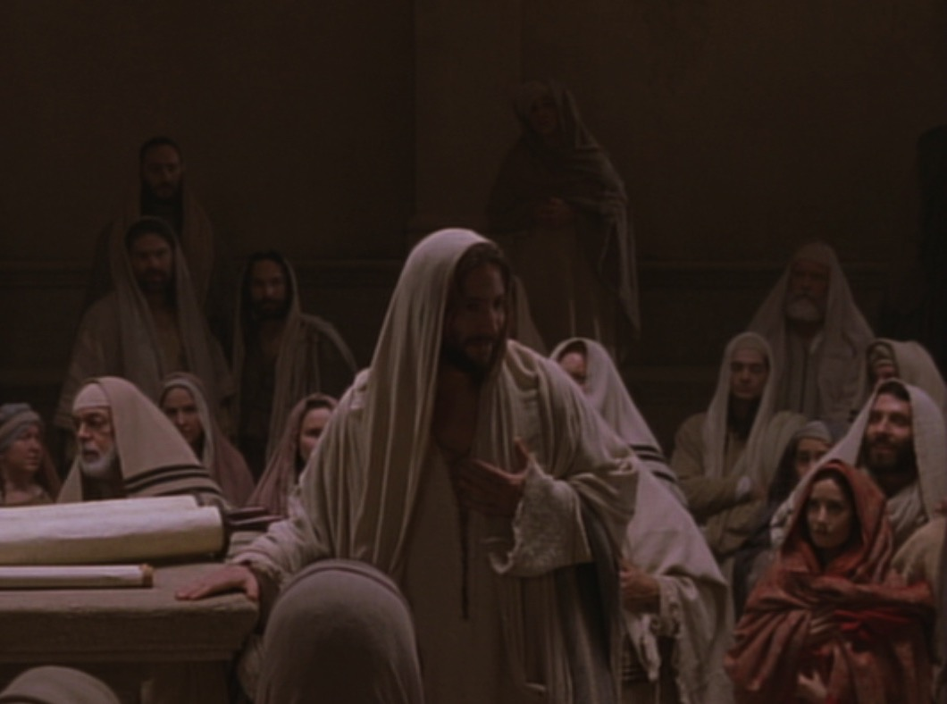
Key Word Believe
John
107
Key Verse
“Jesus did many other miraculous signs in the presence of his disciples, which are not recorded in this book. But these are written that you may believe that Jesus is the Christ, the Son of God, and that by believing you may have life in his name” (20:30-31).

Slide 29
Textual Variants of John 20:31
110
Evangelistic
“…these are written that you may believe that Jesus is the Christ, the Son of God, and that by believing you may have life in his name”
Edification
“…these are written that you may go on believing that Jesus is the Christ, the Son of God, and that by believing you may have life in his name”
Aorist Subjunctive
i-na pisteu,shte
37 manuscripts
Many but later manuscripts
Present Subjunctive
i-na pisteu,hte
p⁶⁶ & a* Few but early manuscripts
Notes:
Most of the manuscripts have the little sigma (= English “s”) that makes the verb for believe in an undefined sense. However, a few early MSS lack this sigma, which turns it into a present tense.

Slide 30
John's Key Idea:
Jesus' resurrection meets each of us at our point of need (John 20).

Slide 31
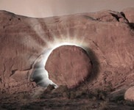
Trust the Living Savior to Meet Your Need Today!
Despair
Comfort
Discouraged
Encouraged
Doubt
Proof
Notes:
31
31

Slide 32
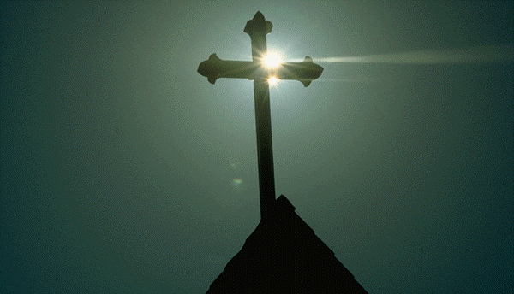
What's So Good About Good Friday?
Jesus controlled His own arrest
Jesus' illegal trials proved Him innocent
Jesus' death paid for our sin
Jesus' resurrection proved He gives eternal life

Slide 33
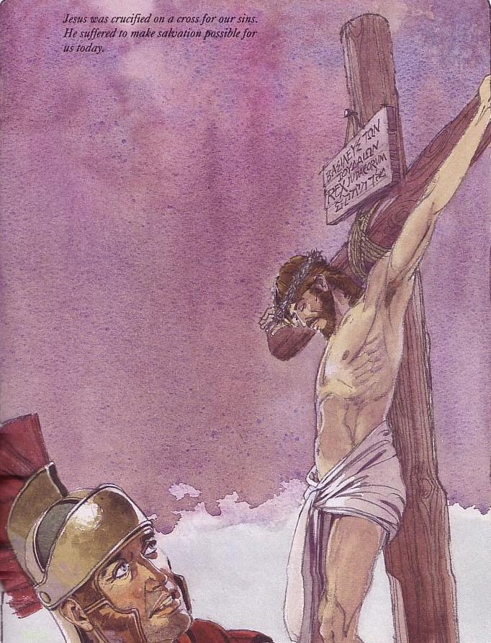
Good Friday is good because on this day Jesus Christ paid for your sin.

Slide 34
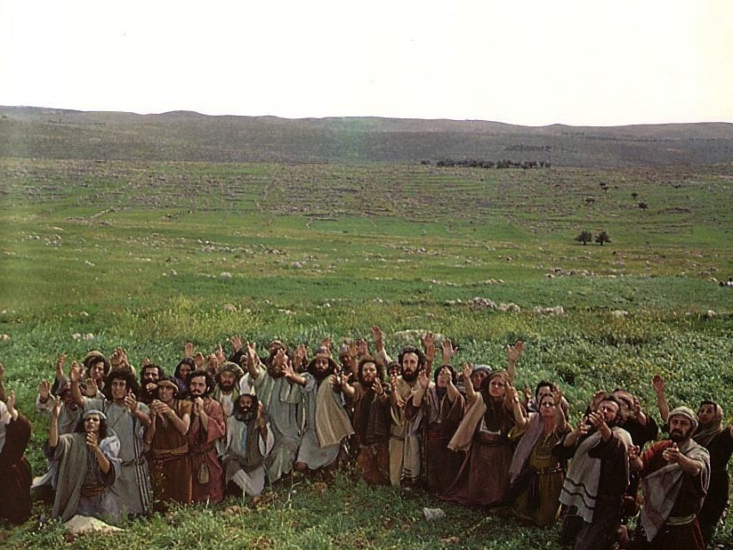
Jesus ascended to the Father
This means he is alive now!

Slide 35
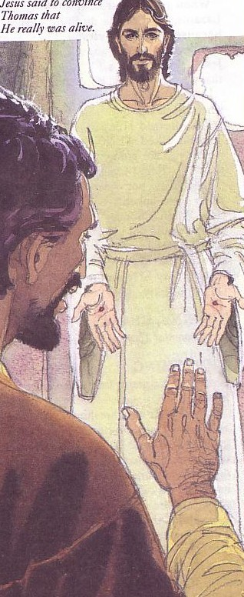
Jesus rose to give you new life!
Jesus rose to give you new life!

Slide 36
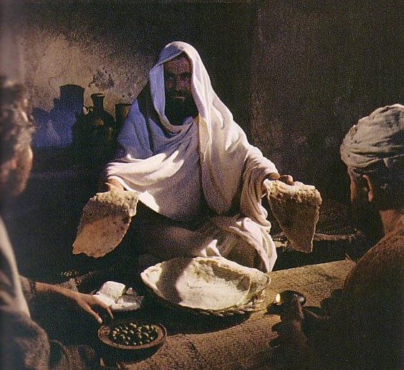
How can you know Him?
Admit you have sinned
Believe that Jesus died for you
Confess that you want to turn from sin

Slide 37
Black
Notes:
37
37

Slide 38
Christology link at BibleStudyDownloads.org
Get this presentation for free!
Notes:
Creation (cr)

